Slide 1
Capstone Engagement
Assessment, Analysis, and Hardening of a Vulnerable System

Slide 2
Table of Contents
This document contains the following sections:
01
Network Topology
02
Red Team: Security Assessment
03
Blue Team: Log Analysis and Attack Characterization
Hardening: Proposed Alarms and Mitigation Strategies
04

Slide 3
Network Topology
‹#›

Slide 4
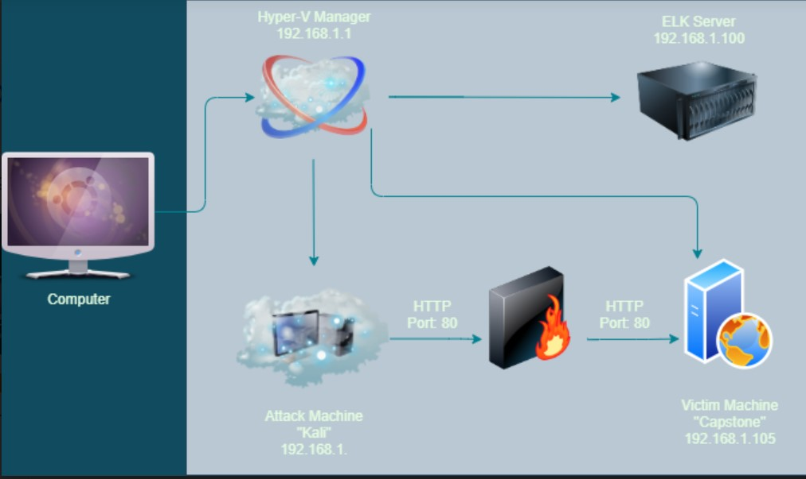
Network Topology
Network
Address Range: 192.168.1.0/24
Netmask: 255.255.255.0
Gateway: 192.168.1.1
Machines
IPv4: 192.168.1.1
OS: Windows
Hostname: Hyper-V Manager
IPv4: 192.168.1
OS: Kali Linux
Hostname: Kali
IPv4: 192.168.1.105
OS: Linux
Hostname: Capstone
IPv4: 192.168.1.100
OS: Linux
Hostname: ELK

Slide 5

Red Team
Security Assessment
‹#›

Slide 6
Recon: Describing the Target
Nmap identified the following hosts on the network:
Hostname | IP Address | Role on Network
Capstone | 192.168.105 | Target machine using the apache web server.
Kali | 192.168.1 | Attacking machine using Kali linux.
ELK | 192.168.1.100 | Logging Service used to identify problems in a server or application.
Hyper-V | 192.168.1.1 | Software that is virtualizing hardware into virtual machines/servers.

Slide 7
Vulnerability Assessment
The assessment uncovered the following critical vulnerabilities in the target:
Vulnerability | Description | Impact
Open Port 80 | Open ports can allow attackers to access private information and increase the risk of a data breach. | This allowed the red team to find private directory with accessible files.
Accessible Files | Web servers, FTP servers, and similar servers may store a set of files underneath a "root" directory that is accessible to the server's users. | This allowed the red team to view the files after accessing the IP on port 80 on Firefox. From there, the red team obtained the server’s users and secret file information.
Hashed Password | A hashed password can be cracked through different tools like John the Ripper, hashcat, and other online tools. It can take only minutes to crack if the password is not salted. | This allowed the red team to use md5cracker to identify the password for John, which was linux4u.

Slide 8
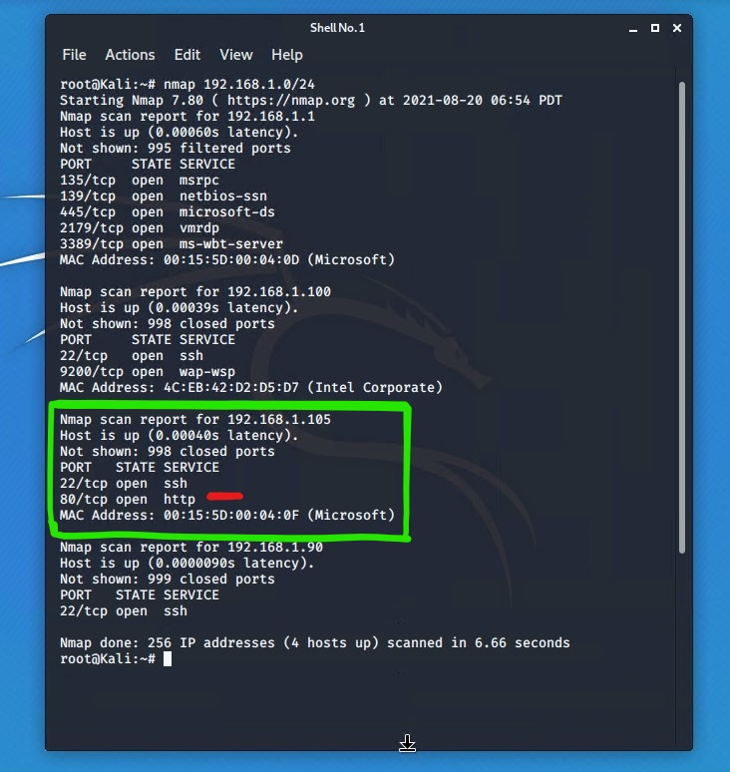
Exploitation: Port 80
01
02
03
Tools & Processes
NMap was used to scan for any open ports and services in the network
Achievements
It was found that IP address 192.168.1.105 had port 80 (HTTP) open and this was used to gain access.

Slide 9
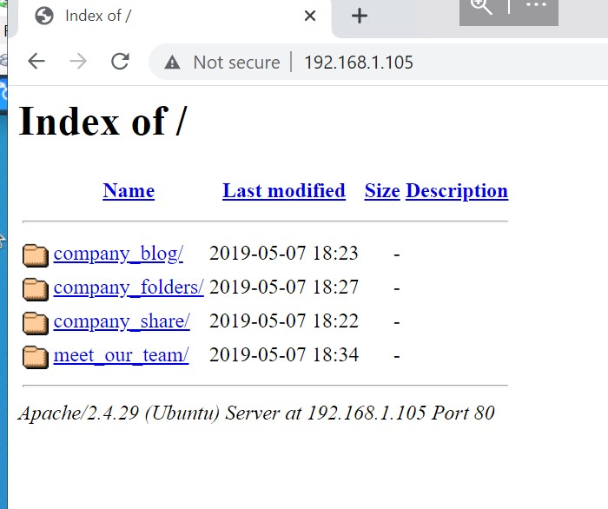
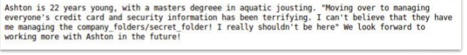
Exploitation: Accessible Files
01
02
03
Tools & Processes
Using the open port 80, we opened a web browser to see if there was anything important to view.
Achievements
Accessing the files gave us intel on which users had access to what and that where their secret files were located.

Slide 10
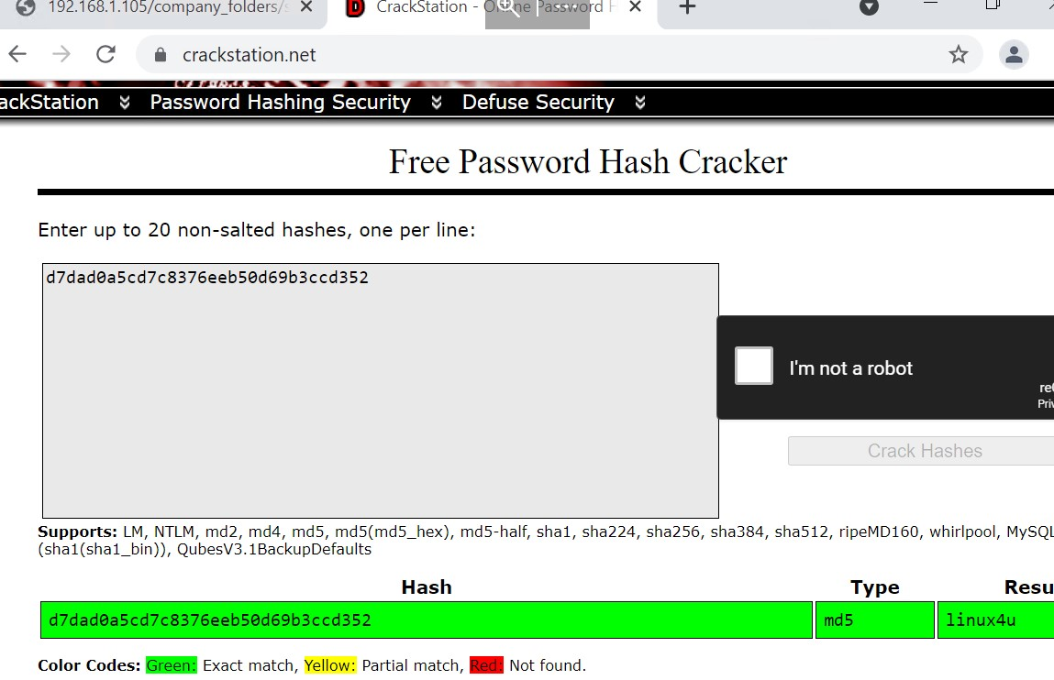
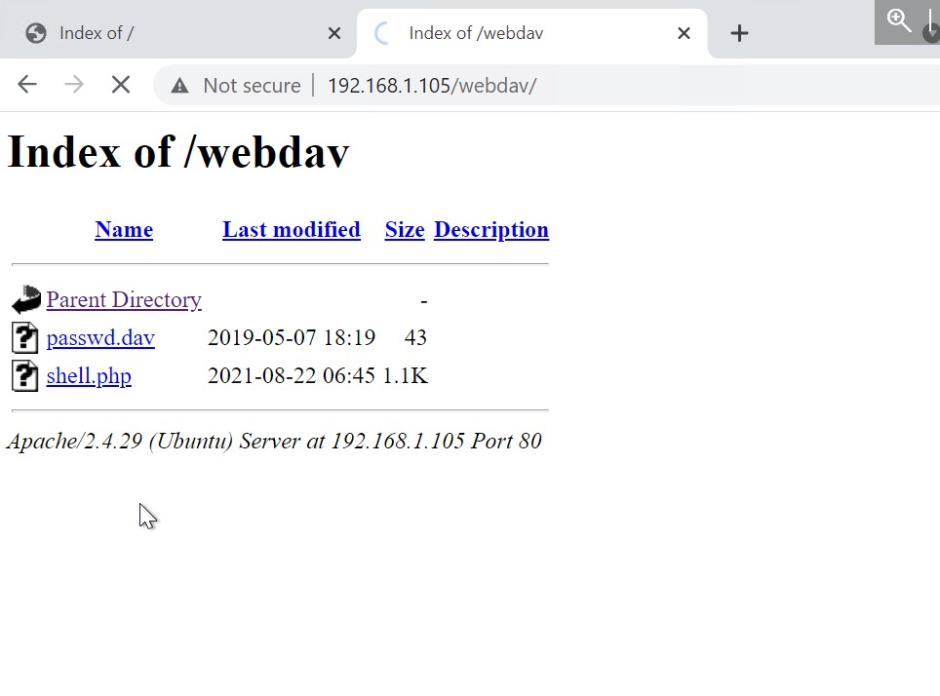
Exploitation: Hashed Password
01
02
03
Tools & Processes
We used the website Crackstation.net to find the plaintext of the hashed password for Ryan.
Achievements
This password granted us access to the system through the WebDav connection, which later allowed us to upload a shell script to attack.

Slide 11

Blue Team
Proposed Alarms and Mitigation Strategies
‹#›

Slide 12
Mitigation: Blocking the Port Scan
What kind of alarm can be set to detect future port scans?
An alarm can be setup to detect when more than 10 port scans happen within a single minute or if 100 consecutive requests occur.
Majority of firewalls and IPSs can be used to detect these types of scans and can even cut it off in real time.
What configurations can be set on the host to mitigate port scans?
Allow traffic that is needed to access the host(s) and deny everything else that is not needed.
This works for standard ports such as TCP 80 for HTTp and ICMP for ping requests. .

Slide 13
Mitigation: Finding the Request for the Hidden Directory
What kind of alarm can be set to detect future unauthorized access?
An alarm can be set to go off when an IP address not on the whitelist attempts to access the directory or file.
What threshold would you set to activate this alarm?
The threshold wor the alarm would be 1 for any/all machines attempting access.
What configuration can be set on the host to block unwanted access?
Thee directory should not be allowed to exist on the server.
Remove the directory and/or file from a server.
Terminal Command: rm -r
Move the directory to a safer/offline location if needed.

Slide 14
Mitigation: Preventing Brute Force Attacks
What kind of alarm can be set to detect future brute force attacks?
An alert can be created if “401 Unauthorized” is returned from the server over a threshold.
Start with 5 attempts in 30 minutes and refine as needed.
What configuration can be set on the host to block brute force attacks?
Limit failed login attempts
Limit logins to a whitelist of IP addresses
Configure an Account policy to the server to limit the failed login attempts.

Slide 15
Mitigation: Detecting the WebDAV Connection
What kind of alarm can be set to detect future access to this directory?
Create an alert for any blacklisted IPs attempting to access this directory
All IPs outside of the set server range should be blacklisted.
The threshold for this alarm will be set at 1 and any attempts to access should trigger the alarm.
What configuration can be set on the host to control access?
Connections to this shared folder should not be accessed from a web interface
Connections to the shared folder should be restricted by the machine firewall rule.
Block ports 80 and 442
Blacklisting all external IPs

Slide 16
Mitigation: Identifying Reverse Shell Uploads
What kind of alarm can be set to detect future file uploads?
Set an alert for any .php file that is uploaded
Set the firewall to block traffic to the shared folder from the ports 80, 443 and 4444
Threshold will be 1 attempt and any traffic on these ports would warrant an alarm trigger
What configuration can be set on the host to block file uploads?
Remove the ability to upload files from over the web.
All files that are uploaded should be from local source
Keep ports 80, 443, and 4444 blocked

